Slide 1

SMART SYSTEM FOR OPTIMIZED ORGANIC CROP ROTATION USING PRECISION AGRICULTURE DATA
Project ID : TMP-23-113
Project ID: TMP-23-113
03/29/2023
1

Slide 2
Team Members
Supervisor : Mr Udara Samarathunga
Co Supervisor : Dr Nuwan Kodagoda
Student Name | Student ID
Ranasinghe R.A.D.M | IT20244552
Ihalagedara I.H.U.B | IT20224820
Samarakoon S.M.A.D | IT20233808
Waththaldeniya N.M | IT20151874
Project ID: TMP-23-113
03/29/2023
2

Slide 3
Introduction
Agriculture is one of the key areas in Sri Lanka's economy.
With the current situation in the country, people tend to go with the organic cultivation.
Most people doesn't have the knowledge about concept of crop rotation due to lack of knowledge about the field.
What is crop rotation? How is it done? What are the data involving?

Slide 4
Objectives
Specific Objective: The main objective of this system is to provide the opportunity for the stakeholders to create their crop rotation plan with the help analysis of soil, climate and pests.
Sub Objective :
Gather soil data using IoT device and use it as parameters in an algorithm
Identify the pests and diseases based on the provided image and provide solutions through an algorithm.
Gather climate data using IoT device and use it as a parameters in an algorithm
Project ID: TMP-23-113
03/29/2023
4

Slide 5
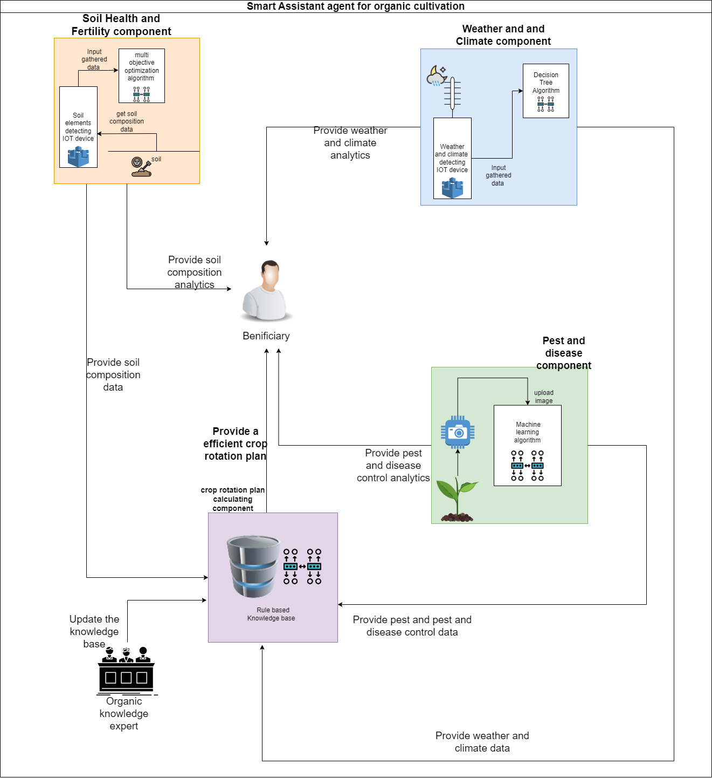
System Overview Diagram
Project ID: TMP-23-113
03/29/2023
5

Slide 6
Research Gap
There are no any system that address the organic crop rotation planning in Sri Lankan context.
Existing platforms doesn't take the measured data for the crop rotation plan.
Usage of providing organic and nonchemical solutions for the identified problems.
Project ID: TMP-23-113
03/29/2023
6

Slide 7
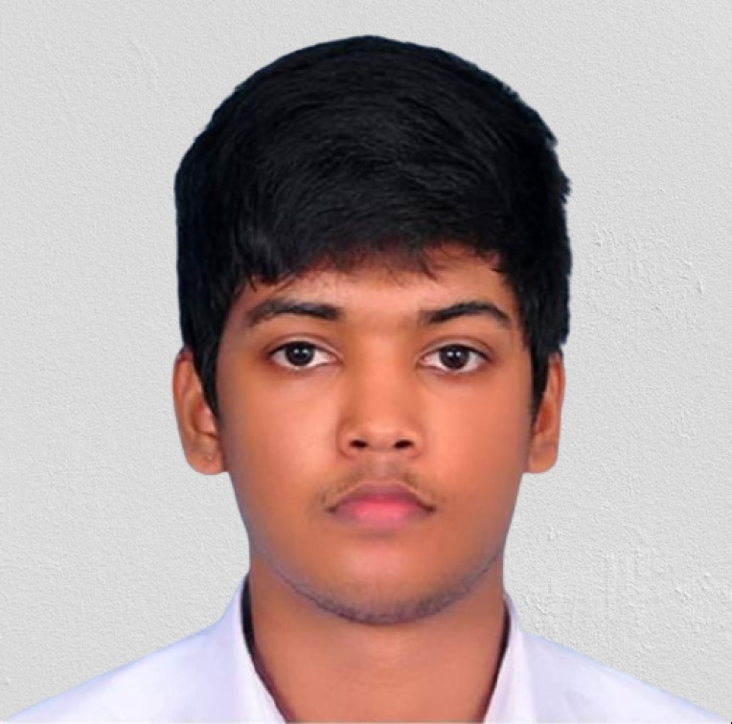
IT20233808 Samarakoon S.M.A.D
Bachelor of Science (Hons) in Information Technology Specializing in Software Engineering
03/29/2023
7
IT20233808 | Samarakoon S.M.A.D. | Project ID: TMP-23-113

Slide 8

Introduction
03/29/2023
IT20233808 | Samarakoon S.M.A.D. | Project ID: TMP-23-113

Slide 9
Background
•Artificial farming methods have a negative impact on the environment, including soil damage, water pollution, and a loss of biodiversity
•In Sri Lanka farmers are facing lot of issues due to not having a proper way to manage soils NPK levels
•There are several IoT devices to measure NPK levels of the soils but there still not addressing the soil issues facing by the farmers
IT20233808 | Samarakoon S.M.A.D. | Project ID: TMP-23-113
03/29/2023

Slide 10
Research Gap
Using IOT devices for gtaher real time soil data
Integrating IoT devices with optimization algorithms for crop selection
Software solution that equipped with IOT devices to suggest crops using Multi objective optimization techniques.
03/29/2023
IT20233808 | Samarakoon S.M.A.D. | Project ID: TMP-23-113

Slide 11


Research Gap Summary
App/Feature | IoT based Soil Nutrients Analysis and Monitoring System for Smart Agriculture[1] | IoT-Based Systems for Soil Nutrients Assessment in Horticulture[2] | Multi-Objective Optimum Solutions for IoT-Based Feature Models of Software Product Line[3] | IoT-Enabled Soil Nutrient Analysis and Crop Recommendation Model for Precision Agriculture[4] | Our solution
Gathering Soils real time NPK levels using IOT devices
Use soils NPK levels for organic precision agriculture
Integrate IOT devices with multi objective optimization techniques
Suggest crops using multi objective optimization techniques
IT20233808 | Samarakoon S.M.A.D. | Project ID: TMP-23-113
03/29/2023

Slide 12
Research Questions
How to get soil data required for organic farming using IOT devices
How use the gathered data with a multi objective algorithm to find the most optimized crop
Finding the best suited multi objective algorithm
03/29/2023
IT20233808 | Samarakoon S.M.A.D. | Project ID: TMP-23-113

Slide 13
Objectives
Main objective : Finding the composition of a given soil sample using IOT device and input the gathered data to a multi objective optimizing algorithm to find the most optimized crop to get high yields with the use of low fertilizers.
IT20233808 | Samarakoon S.M.A.D. | Project ID: TMP-23-113
03/29/2023

Slide 14
Objectives
Sub objective :
Find the chemical elements that can be found on a given soil sample using an IOT device
Input the data into a multi objective optimization algorithm
Use the output of multi objective optimization algorithm to predict most optimized crop for get high yields with low fertilizers
03/29/2023
IT20233808 | Samarakoon S.M.A.D. | Project ID: TMP-23-113

Slide 15

Methodology
IT20151874 | Waththaladeniya N.M | Project ID: TMP-23-113
03/29/2023

Slide 16
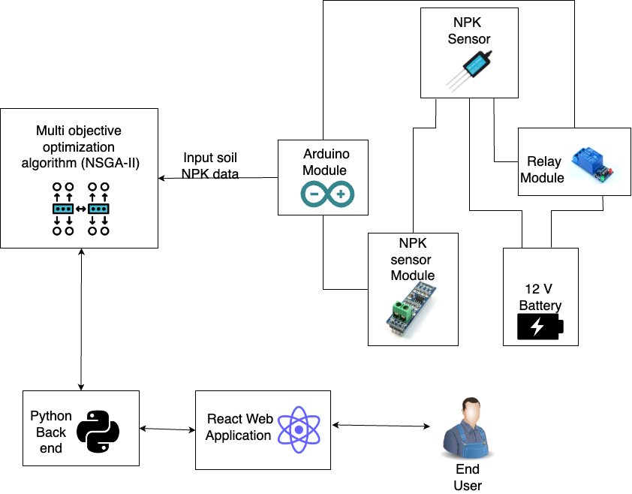
Component Overview Diagram
IT20233808 | Samarakoon S.M.A.D. | Project ID: TMP-23-113
03/29/2023

Slide 17
Tools and Technologies
Technology
Internet of Things (IoT)
Multi objective optimization algorithm
Tools
Frontend – ReactJS
Languages – typescript, python
Backend – Flask
Editor – Visual Studio code
Database - MongoDB
IT20233808 | Samarakoon S.M.A.D. | Project ID: TMP-23-113
03/29/2023

Slide 18
Requirements
Functional Requirements
Gather soil data using IoT device.
Suggesting most optimized crop using soil data and multi objective optimization algorithms
Non-Functional Requirements
Real time data availability
Faster data processing speed
User friendly interfaces for non-technical people
IT20244552 | Ranasinghe R.A.D.M. | Project ID: TMP-23-113
03/29/2023

Slide 19
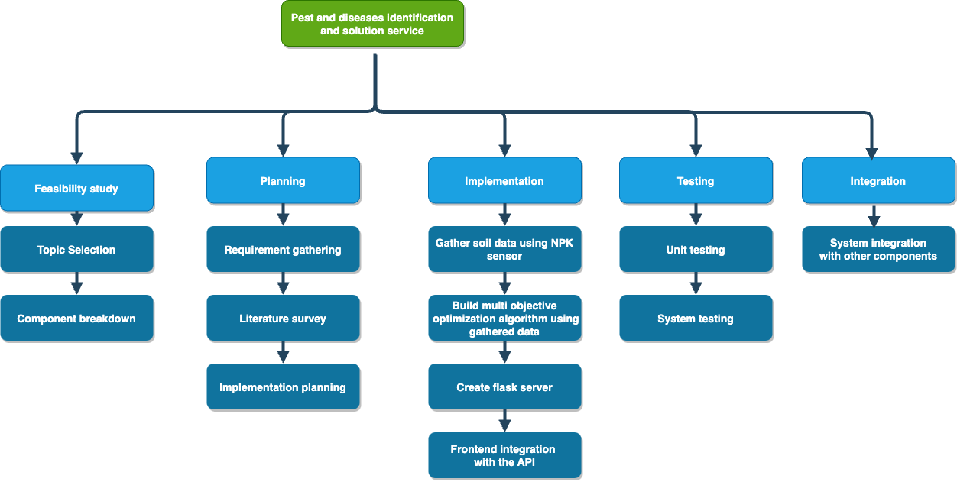
Work Breakdown Structure
IT20151874 | Waththaladeniya N.M | Project ID: TMP-23-113
03/29/2023

Slide 20
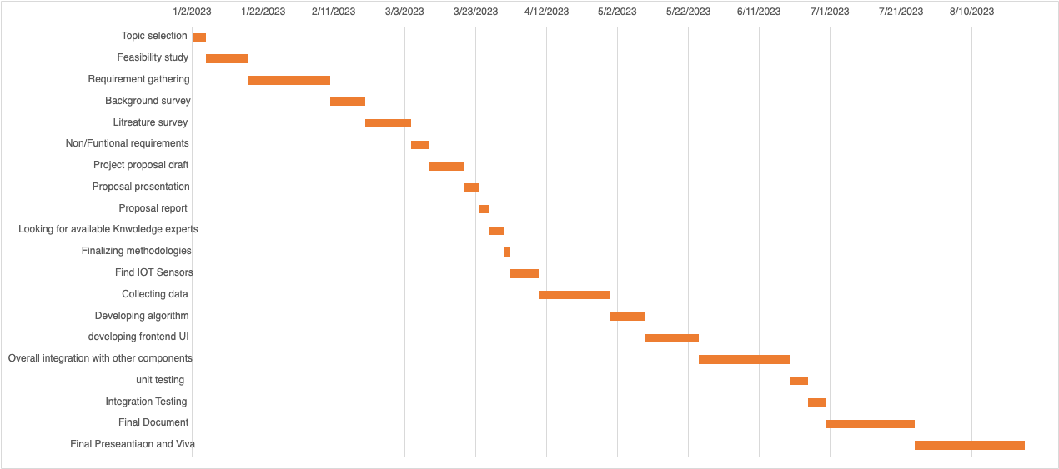
Gantt Chart
IT20244552 | Ranasinghe R.A.D.M. | Project ID: TMP-23-113
03/29/2023

Slide 21
References
[1] IoT based Soil Nutrients Analysis and Monitoring System for Smart Agriculture https://ieeexplore.ieee.org/document/9885371
[2] IoT-Based Systems for Soil Nutrients Assessment in Horticulture https://www.mdpi.com/1424-8220/23/1/403
[3] Multi-Objective Optimum Solutions for IoT-Based Feature Models of Software Product Line https://www.researchgate.net/publication/323441584_Multi-Objective_Optimum_Solutions_for_IoT-Based_Feature_Models_of_Software_Product_Line
[4] IoT-Enabled Soil Nutrient Analysis and Crop Recommendation Model for Precision Agriculture https://www.mdpi.com/2073-431X/12/3/61
IT20244552 | Ranasinghe R.A.D.M. | Project ID: TMP-23-113
03/29/2023

Slide 22
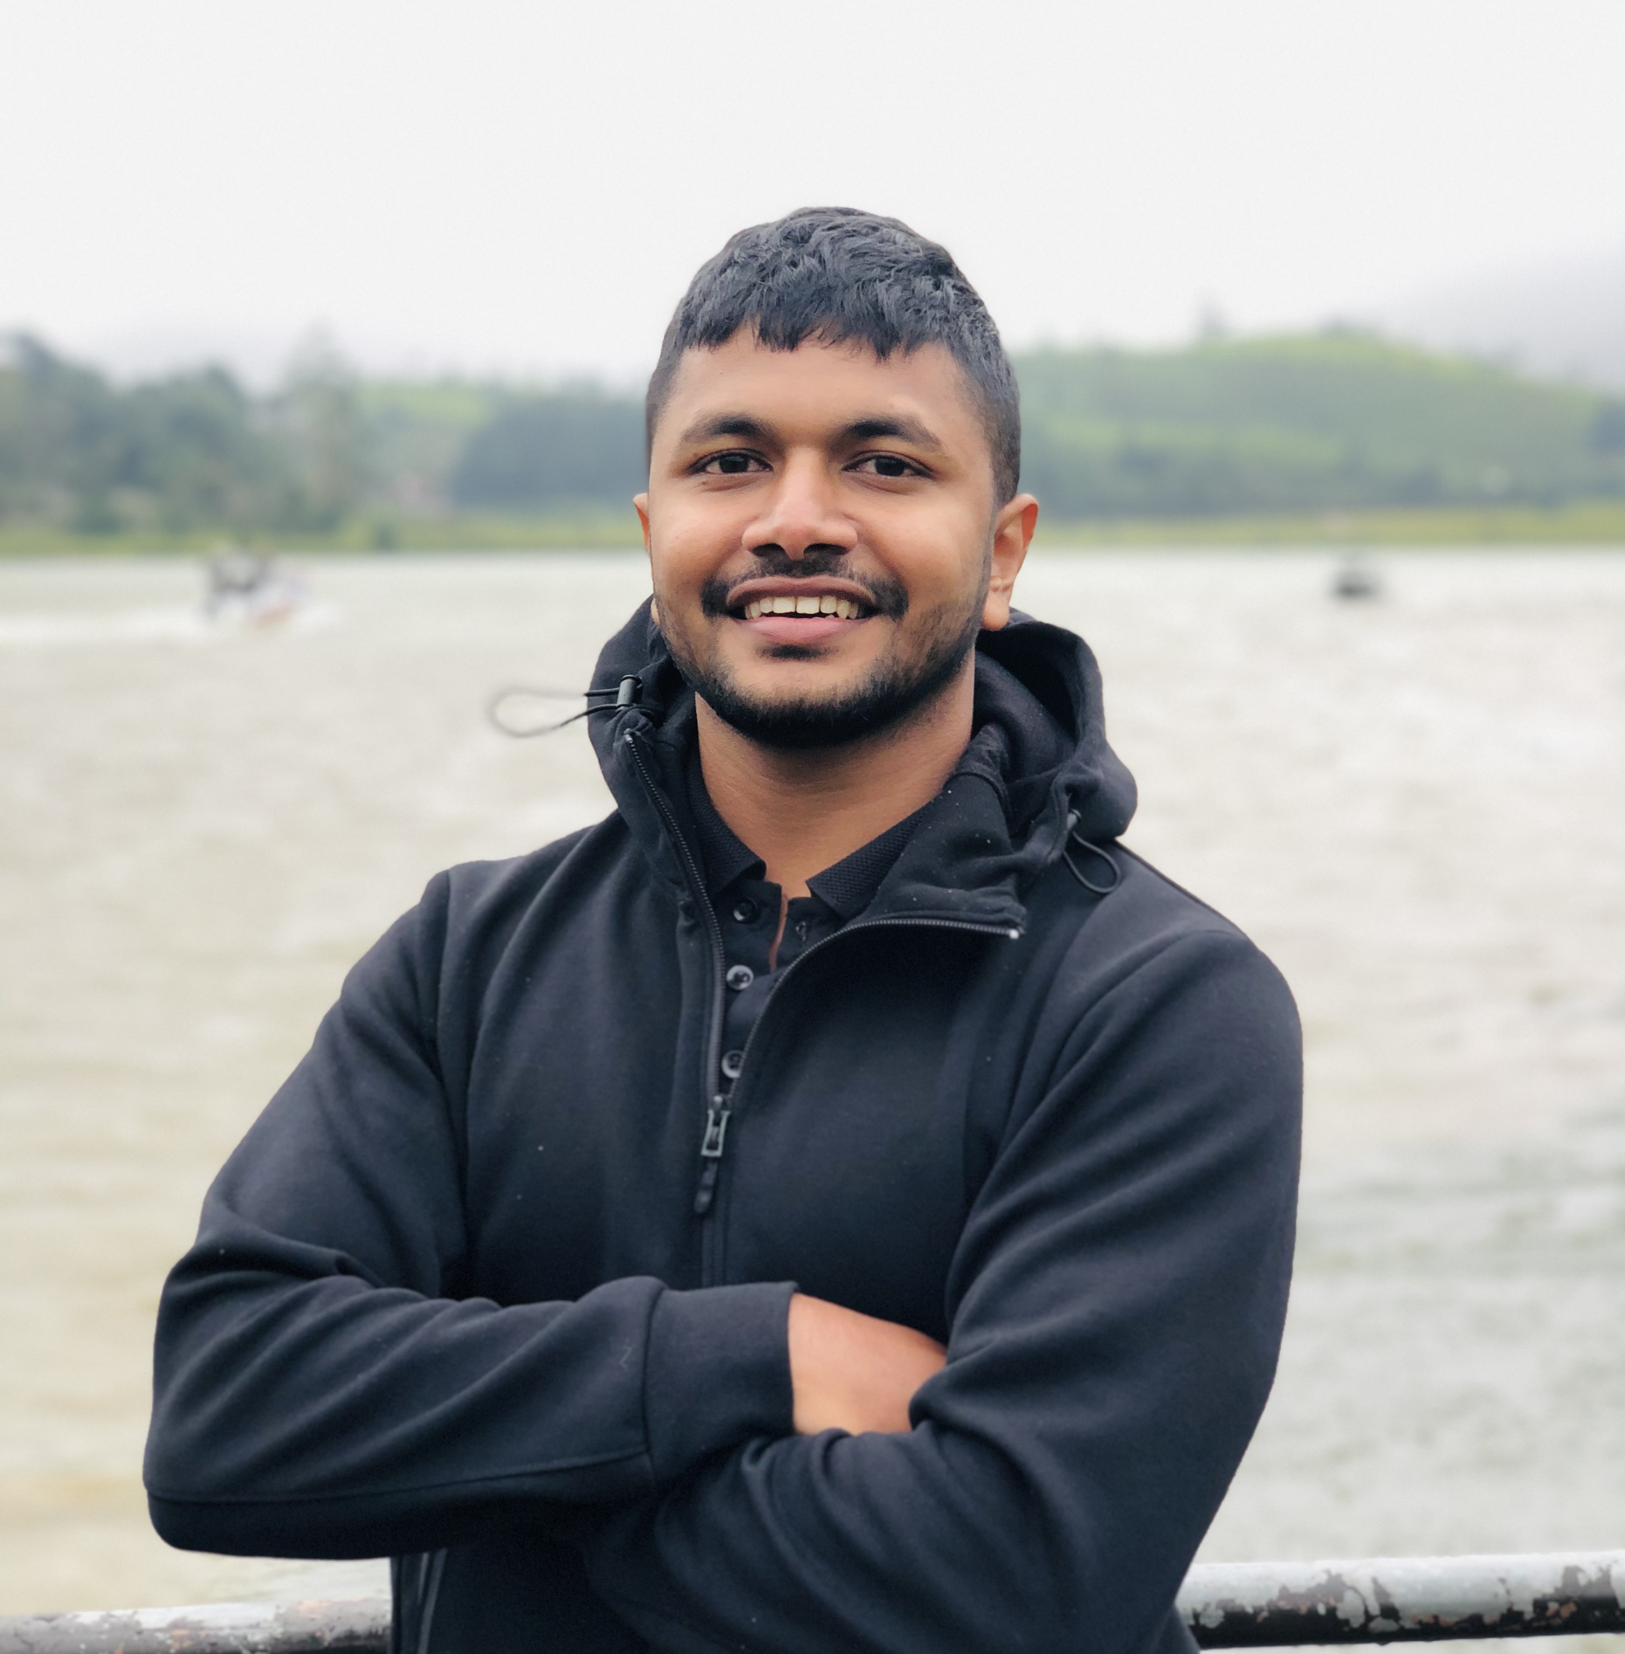
IT20151874 | Waththaladeniya N.M
Bachelor of Science (Hons) in Information Technology Specializing in Software Engineering
IT20151874 | Waththaladeniya N.M | Project ID: TMP-23-113
03/29/2023
22

Slide 23
Introduction
IT20151874 | Waththaladeniya N.M | Project ID: TMP-23-113
03/29/2023

Slide 24
Background
Reduce the effect on weather changes based on traditional knowledge.
Weather monitoring systems to monitor the weather changes.
IT20151874 | Waththaladeniya N.M | Project ID: TMP-23-113
03/29/2023

Slide 25
Research Gap
Provide recommendations to reduce the impact on organic crop based on weather changes.
Recommend crops based on real-time weather conditions.
IT20151874 | Waththaladeniya N.M | Project ID: TMP-23-113
03/29/2023

Slide 26


Research Gap Summary
CRM Tool Feature | A | B | C | Proposed system
Detect real time weather condition
Recommend solutions based on weather conditions
Recommend organic crop based on weather
IT20151874 | Waththaladeniya N.M | Project ID: TMP-23-113
03/29/2023

Slide 27
Research Questions
How to recommend methods to reduce the effect on organic crops based on weather conditions.
How to recommend organic crops using an algorithm based on weather conditions.
IT20151874 | Waththaladeniya N.M | Project ID: TMP-23-113
03/29/2023

Slide 28
Objectives
Objective : Main objective is finding local varying weather conditions like temperature, precipitation, humidity, wind, and extreme weather conditions to provide recommended crops based on their area weather conditions.
IT20151874 | Waththaladeniya N.M | Project ID: TMP-23-113
03/29/2023

Slide 29
Objectives
Sub Objectives
Collect the real-time weather conditions using IOT device.
Implement a recommendation algorithm to recommend crops based on weather conditions.
IT20151874 | Waththaladeniya N.M | Project ID: TMP-23-113
03/29/2023

Slide 30
Methodology
IT20151874 | Waththaladeniya N.M | Project ID: TMP-23-113
03/29/2023

Slide 31
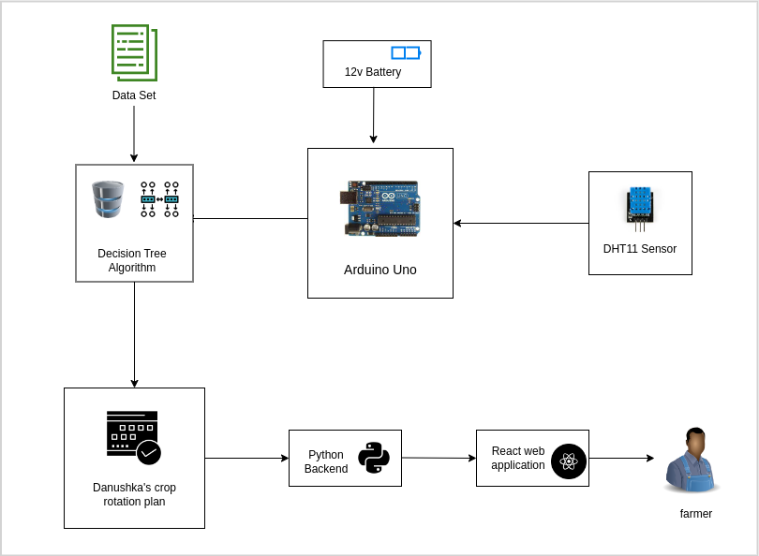
Component Overview Diagram
IT20151874 | Waththaladeniya N.M | Project ID: TMP-23-113
03/29/2023

Slide 32
Tools and Technologies
Technology
Internet of Things (IoT)
Decision Tree algorithm
Tools
Frontend – ReactJS
Languages – typescript, python
Backend – Flask
Editor – Visual Studio code
Database - MongoDB
IT20151874 | Waththaladeniya N.M | Project ID: TMP-23-113
03/29/2023

Slide 33
Requirements
Functional Requirements
Identify weather conditions using IOT device.
Recommend crops based on the weather condition using algorithm.
Non-Functional Requirements
Real time weather conditions.
User friendly interface for farmers to check weather conditions.
IT20151874 | Waththaladeniya N.M | Project ID: TMP-23-113
03/29/2023

Slide 34
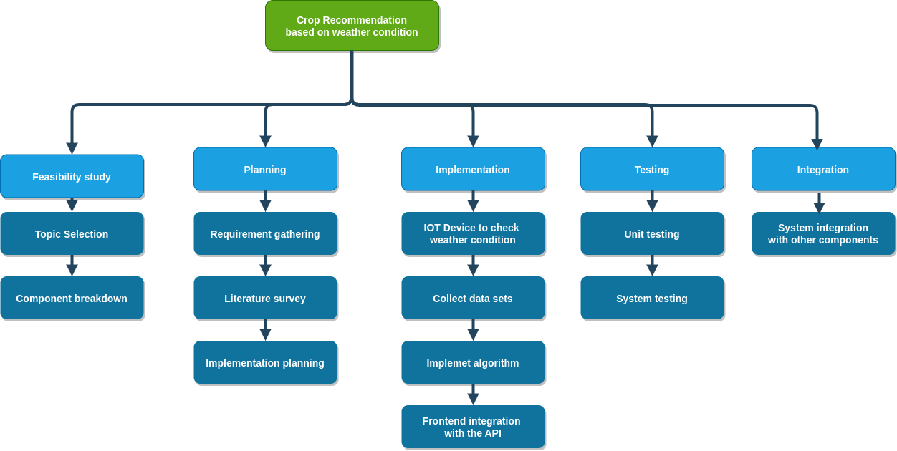
Work Breakdown Structure
IT20151874 | Waththaladeniya N.M | Project ID: TMP-23-113
03/29/2023

Slide 35
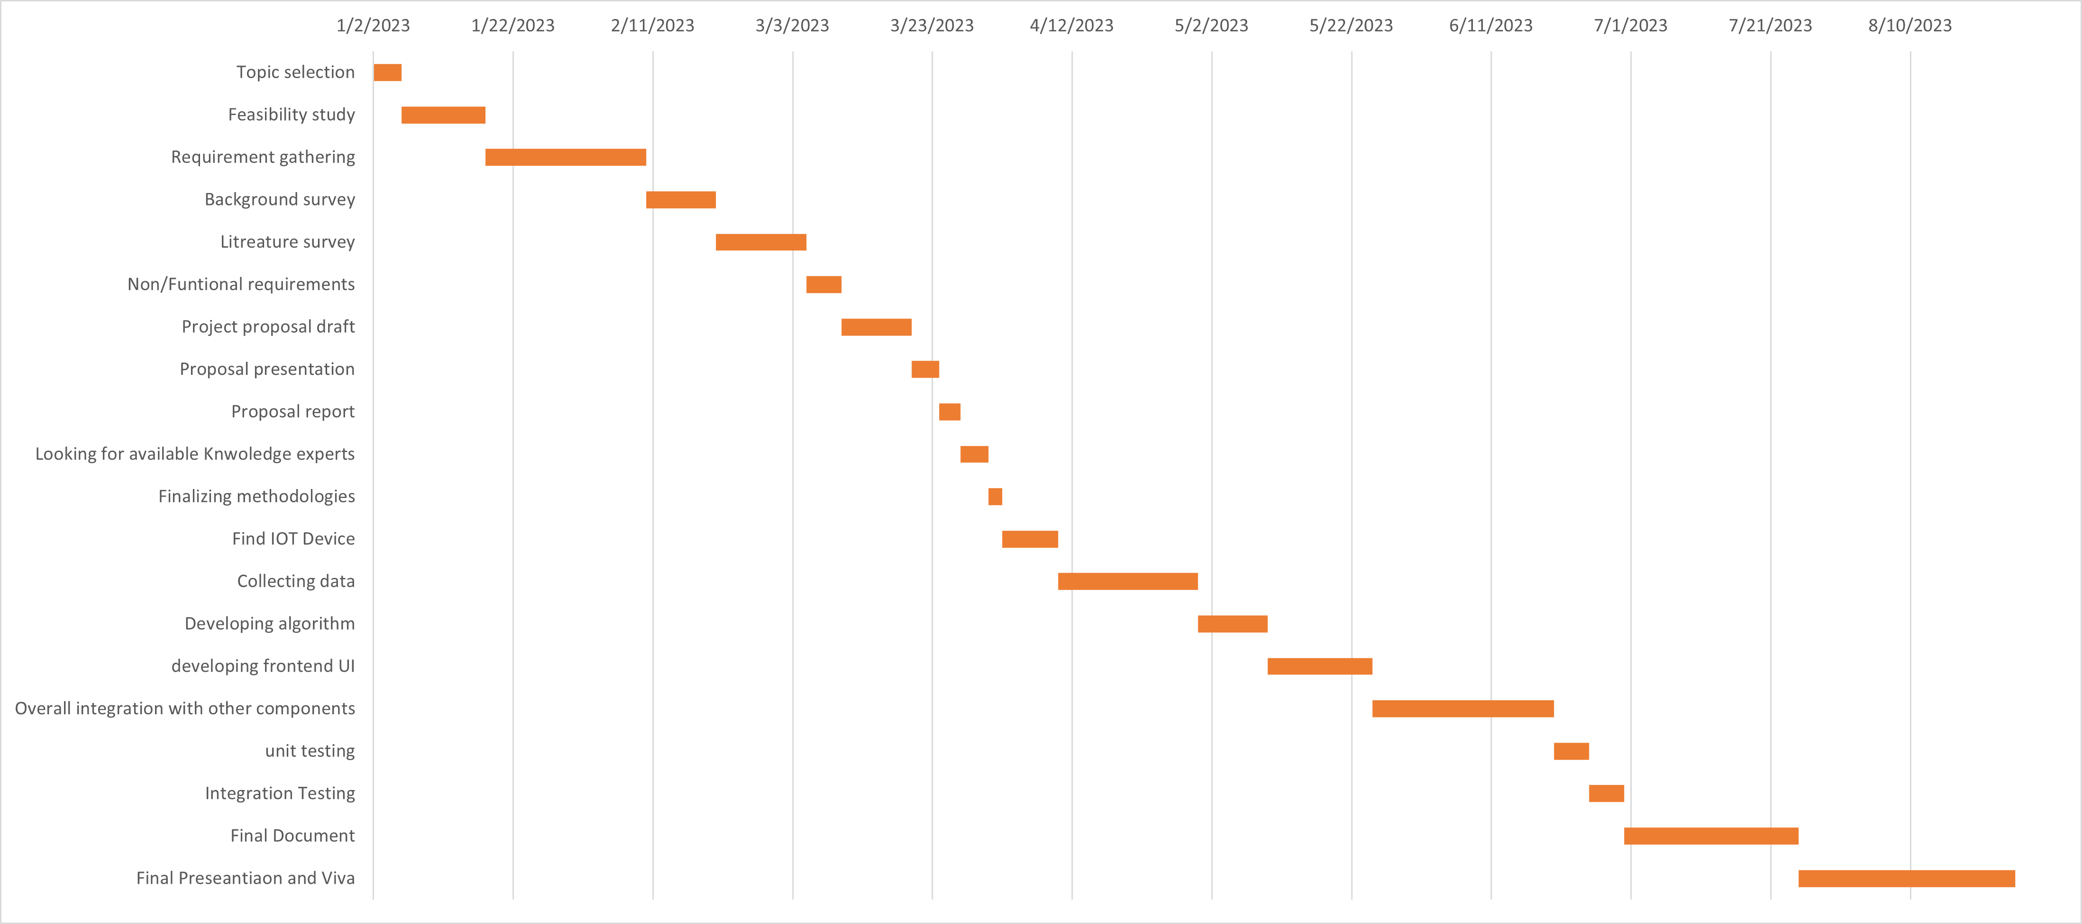
Gantt Chart
IT20151874 | Waththaladeniya N.M | Project ID: TMP-23-113
03/29/2023

Slide 36
References
[1]: Jitendra Patel, G Shiva Kumar, Climate Resilient Agriculture Practices - The Future of Farming,
[2]: Amarasingam Narmilan, Pirapuraj Ponnampalam, An IoT based Low-cost Weather Monitoring System for Smart Farming,
[3]: H.G.C.R. Laksiri; H.A.C. Dharmagunawardhana; J.V. Wijayakulasooriya, Design and Optimization of IoT Based Smart Irrigation System in Sri Lanka,
[4]: Dilani Hirimuthugodage, Sri Lankan farmers’ traditional knowledge and climate change predictions,
[5]: Buddhi Marambe, Ranjith Punyawardena, Pradeepa Silva, Sarath Premalal, Varuna Rathnabharathie, Bhathiya Kekulandala, Uday Nidumolu & Mark Howden , Climate, Climate Risk, and Food Security in Sri Lanka: Need for Strengthening Adaptation Strategies,
[6]: W.A.J.M. De Costa, Adaptation of agricultural crop production to climate change,
IT20151874 | Waththaladeniya N.M | Project ID: TMP-23-113
03/29/2023

Slide 37
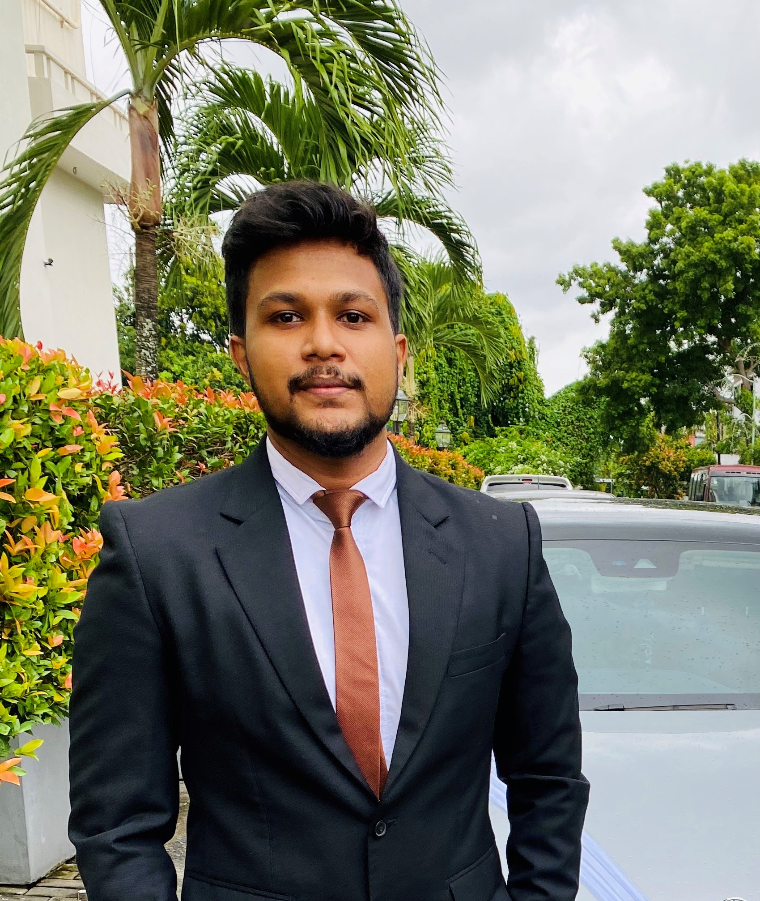
IT20224820 | Ihalagedara I.H.U.B
Bachelor of Science (Hons) in Information Technology Specializing in Software Engineering
IT20224820 | Ihalagedara I.H.U.B | Project ID: TMP-23-113
03/29/2023
37

Slide 38
Introduction
IT20224820 | Ihalagedara I.H.U.B | Project ID: TMP-23-113
03/29/2023

Slide 39
Background
Agriculture is one of the key areas in Sri Lanka’s economy.
Pest identification and management has become a key problem.
Lack of knowledge in organic and natural solutions as pesticides.
Lack of knowledge in pests' management.
Wasting money, time and healthiness with chemical solutions.
IT20224820 | Ihalagedara I.H.U.B | Project ID: TMP-23-113
03/29/2023

Slide 40
Research Gap
Usage of a system to provide nonchemical and organic solutions to help the crop rotation in Sri Lanka.
Identifying the pests or diseases through an image and provide the traditional and organic solutions.
Creation of algorithm for a knowledge base system for provide the necessary solutions.
IT20224820 | Ihalagedara I.H.U.B | Project ID: TMP-23-113
03/29/2023

Slide 41
Research Gap Summary
Feature | Pest detection system for smart agriculture | Pest and disease detection system with machine learning | Insect classification with machine learning algorithms | Proposed system
Detect Pests with a provided image
Detect diseases based on the image provided
Provide information about the pest and disease
Provide nonchemical and organic solutions with a knowledge bae s
IT20224820 | Ihalagedara I.H.U.B | Project ID: TMP-23-113
03/29/2023

Slide 42
Research Questions
How to detect the pests based on the image provided.
How to get the solutions for the identified objects through the available dataset.
How to create the system to provide the traditional solutions or ways to prevent identified pests or diseases through the trained model.
IT20224820 | Ihalagedara I.H.U.B | Project ID: TMP-23-113
03/29/2023

Slide 43
Objectives
Main objective : The main objective of this component is to create a way to identify pests and diseases with a trained model and object detection algorithms for the users and provide them with the necessary non-chemical natural solutions.
IT20224820 | Ihalagedara I.H.U.B | Project ID: TMP-23-113
03/29/2023

Slide 44
Objectives
Sub objectives :
•Create an algorithm to identify the pests.
Create an algorithm to identify leaf diseases.
•To understand about the traditional organic crops and non-chemical pesticides for productive cultivation.
•To provide a smart solution to provide decisions to the user.
IT20224820 | Ihalagedara I.H.U.B | Project ID: TMP-23-113
03/29/2023

Slide 45
Methodology
IT20224820 | Ihalagedara I.H.U.B | Project ID: TMP-23-113
03/29/2023

Slide 46
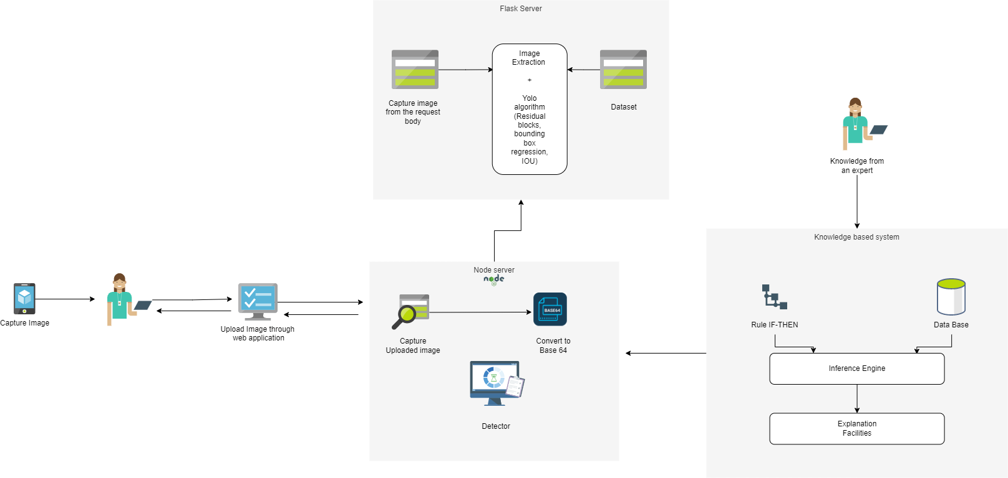
Component Overview Diagram
IT20224820 | Ihalagedara I.H.U.B | Project ID: TMP-23-113
03/29/2023

Slide 47
Tools and Technologies
Technology
Object detection
Tools
Frontend – ReactJS
Languages – JavaScript, python
Backend – Flask
Editor – Visual Studio code
Object detection and algorithms – YOLO ,CNN
Database - MongoDB
IT20224820 | Ihalagedara I.H.U.B | Project ID: TMP-23-113
03/29/2023

Slide 48
Requirements
Functional Requirements
• The system should be able to identify pests based on the provided images.
• The system should be able to identify diseases based on the provided images.
•The system should provide the solutions for the above identified objects with the knowledge base system.
•Identified data should provide to create the crop rotation plan.
Non-Functional Requirements
The accuracy should be high.
The system should be available without any downtime.
Speed functioning between components.
User friendly interfaces and better user experience.
IT20224820 | Ihalagedara I.H.U.B | Project ID: TMP-23-113
03/29/2023

Slide 49
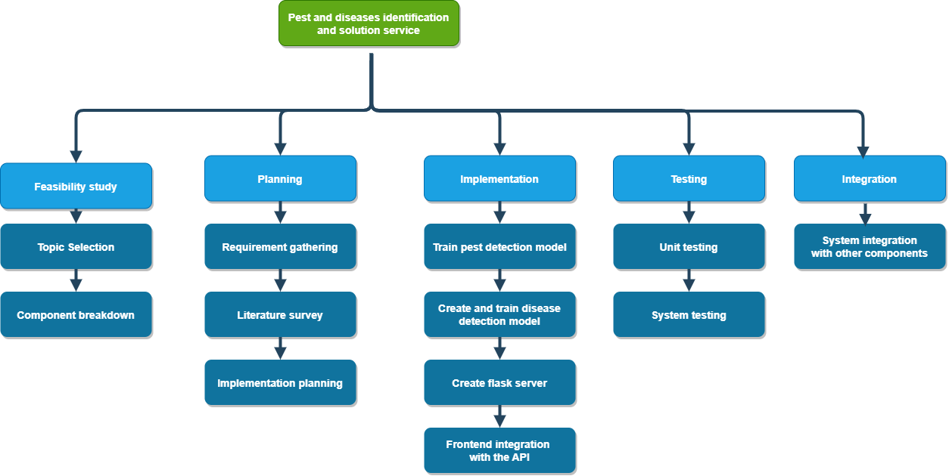
Work Breakdown Structure
IT20224820 | Ihalagedara I.H.U.B | Project ID: TMP-23-113
03/29/2023

Slide 50
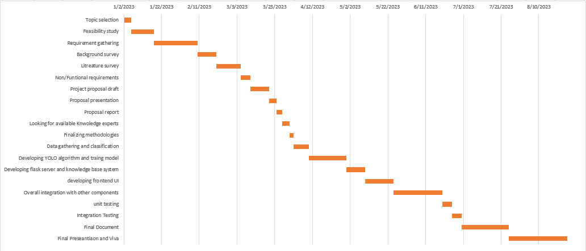
Gantt Chart
IT20224820 | Ihalagedara I.H.U.B | Project ID: TMP-23-113
03/29/2023

Slide 51
References
[1] R. Dufour, "Crop Rotation in Organic Farming Systems," 2015. [Online]. Available: https://attra.ncat.org/publication/tipsheet-crop-rotation-in-organic-farmingsystems/.
[2] U. R. U. M. D. D. P. W. W. A.K.A Dissanayake, "Possibilities to Minimize Pesticide Usage in Sri Lankan Paddy Cultivation," harti.gov.lk, p. 69.
[3] M. o. P. I. &. M. o. Agriculture, "Pest Management Plan," 2016. [Online]. Available: https://www.agrimin.gov.lk/web/images/Pest_Management_Plan.pdf.
[4] R. K. Bank, "Rice Knowledge bank," 2018. [Online]. Available: http://www.knowledgebank.irri.org/step-by-step-production/growth/soilfertility/leaf-color-chart.
[5] D. s. U. S. R. Thenmozhi Kasinathan, "Insect Classification and detection in field crops using modern machine learning techniques," p. 57, 2020.
[6] D. L. B. Jaco.Gomes, "Insect Pest Image Recognition: A few-shot machine learning Approach including Maturity Stages Classification," MDPI, p. 14.
IT20224820 | Ihalagedara I.H.U.B | Project ID: TMP-23-113
03/29/2023

Slide 52
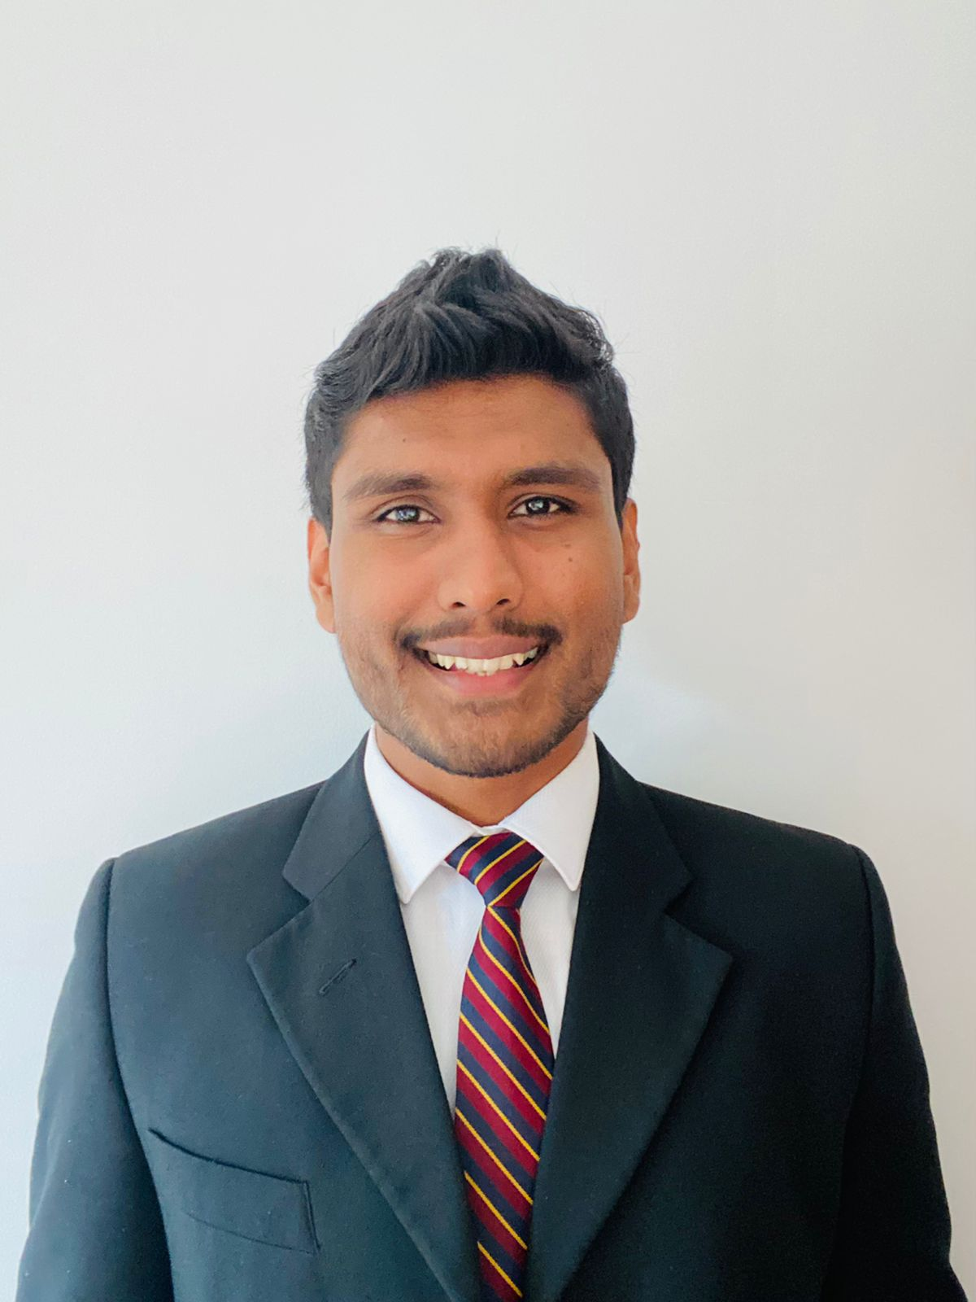
IT20244552 | Ranasinghe R.A.D.M.
Bachelor of Science (Hons) in Information Technology Specializing in Software Engineering
IT20244552 | Ranasinghe R.A.D.M. | Project ID: TMP-23-113
03/29/2023
52

Slide 53
Introduction
IT20244552 | Ranasinghe R.A.D.M. | Project ID: TMP-23-113
03/29/2023

Slide 54
Background
A well-designed crop rotation plan can help to break pest and disease cycles, reduce weed pressure, and improve soil fertility.
Crop rotation planning is, scientifically speaking, a highly complex optimization issue[5] – Julius, Paul and Dieter
Correct planning of crop rotation can address the UN’s SDG-2[5](end hunger, achieve food security and improved nutrition and promote sustainable agriculture)
IT20244552 | Ranasinghe R.A.D.M. | Project ID: TMP-23-113
03/29/2023

Slide 55
Research Gap
There are no any CRM system that address the organic crop rotation planning in Sri Lankan context.
There are no any studies or available systems that use real time precision agriculture data using IOT to create organic crop rotation plan.
There are no any studies or available system that considers current pest and diseases in the farm to create a crop rotation plan.
IT20244552 | Ranasinghe R.A.D.M. | Project ID: TMP-23-113
03/29/2023

Slide 56
Research Gap Summary
CRM Tool Feature | [1]ROTOR 4.1 | [2]FruchtFolge | [3]FARMs | [4]MORDMAgro | Proposed System
Build for organic farming
Can apply output crop rotation plan for Sri Lanka
Use real time precision agriculture data
Consider previous grown crops pest and disease history
IT20244552 | Ranasinghe R.A.D.M. | Project ID: TMP-23-113
03/29/2023

Slide 57
Research Questions
How to create a crop rotation plan according to precision agriculture data?
What are the other parameters that need to consider when creating the crop rotation plan?
How to create the organic agriculture knowledge base. What is the most appropriate type of knowledge-based type that we can use for this issue?
IT20244552 | Ranasinghe R.A.D.M. | Project ID: TMP-23-113
03/29/2023

Slide 58
Objectives
Main Objective -
The main objective of this component is to create and optimize crop rotation plans in organic agriculture using gathered data from precision agriculture tools.
Sub Objectives –
Extract the knowledge of expert in organic crop rotation.
Write the knowledge base respected to considered parameters.
Create the crop rotation plan according to the given output from the knowledge base system .
Integrate the crop rotation plan component with other components.
IT20244552 | Ranasinghe R.A.D.M. | Project ID: TMP-23-113
03/29/2023

Slide 59
Methodology
IT20244552 | Ranasinghe R.A.D.M. | Project ID: TMP-23-113
03/29/2023

Slide 60
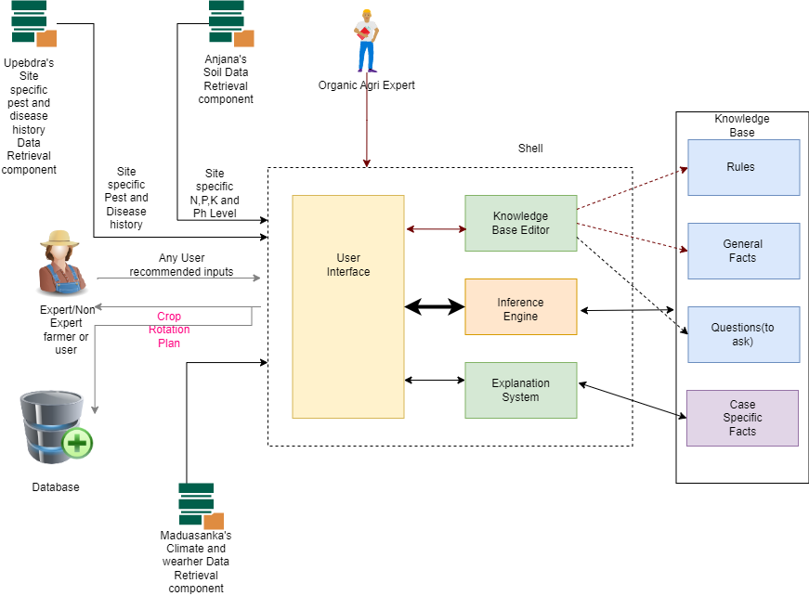
Component Overview Diagram
IT20244552 | Ranasinghe R.A.D.M. | Project ID: TMP-23-113
03/29/2023

Slide 61
Tools and Technologies
Technology
Rule based Expert System
Tools
Frontend – ReactJS
Backend – NodeJS/ Flask
Knowledge Base Framework – PyKE/CLIP’s(Tentative)(In depth research going on)
Database – MongoDB
Editor – Visual Studio code
IT20244552 | Ranasinghe R.A.D.M. | Project ID: TMP-23-113
03/29/2023

Slide 62
Requirements
Functional Requirements
Create a crop rotation plan according to given precision agriculture data
Continuously update the knowledge-based system that crates crop rotation plan
Retrieve the previously suggested crop rotation plan
Non-Functional Requirements
Accuracy of crop rotation plan
User friendly interface for farmers
User friendly interface and knowledge base editor interface for Agri experts
IT20244552 | Ranasinghe R.A.D.M. | Project ID: TMP-23-113
03/29/2023

Slide 63
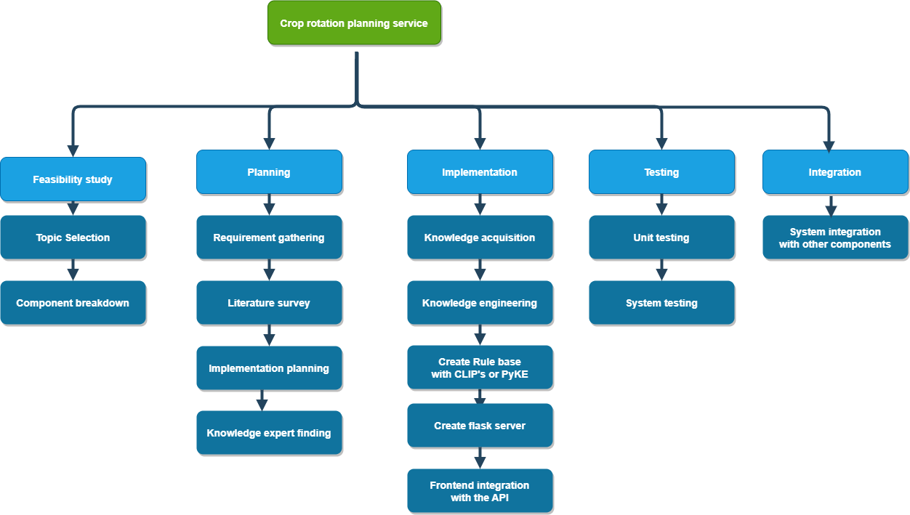
Work Breakdown Structure
IT20244552 | Ranasinghe R.A.D.M. | Project ID: TMP-23-113
03/29/2023

Slide 64
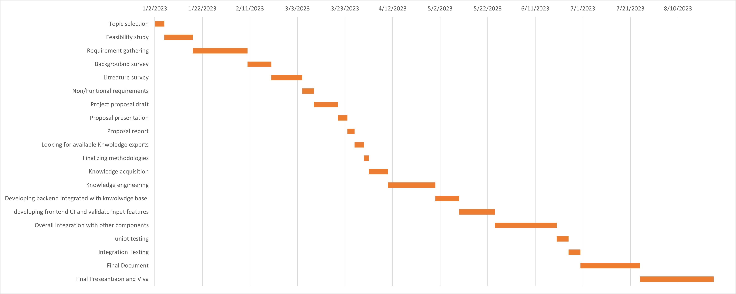
Gantt Chart
IT20244552 | Ranasinghe R.A.D.M. | Project ID: TMP-23-113
03/29/2023

Slide 65
Commercialization
Commercial potential: High demand due to sustainable agriculture trend
Licensing: Offer to farming tech companies for integration
Subscription service: Offer directly to farmers through partnerships
Promotion: Attend conferences, use social media, develop case studies. Key to success: Demonstrate value, establish strong network.
IT20244552 | Ranasinghe R.A.D.M. | Project ID: TMP-23-113
03/29/2023
Notes:
Commercial potential: A crop rotation planning system for organic farming that utilizes precision agriculture data has significant commercial potential due to the increasing demand for organic food and sustainable agriculture.
Licensing: The software can be licensed to farming equipment and technology companies that offer precision agriculture solutions to integrate the crop rotation planning system into their existing product offerings.
Subscription-based service: Another option is to offer the software as a subscription-based service directly to farmers, through partnerships with agriculture consultants, cooperatives, or organic certification organizations.
Promotion: Attend farming and agriculture technology conferences and trade shows, connect with industry influencers and potential customers through social media and targeted advertising, and develop case studies and success stories to showcase the benefits of the software.
Key to success: Demonstrate the value and benefits of the software to farmers, and establish a strong network of industry partners and customers.

Slide 66
References
[1]Krugmann, C. et al. (2022) “Modelling crop rotations and nutrient-balances in organic farming systems,” MATHMOD 2022 Discussion Contribution Volume [Preprint]. Available at: https://doi.org/10.11128/arep.17.a17187.
[2] C. Pahmeyer, T. Kuhn, W. Britz, ‘FruchtFolge’: a crop rotation decision support system for optimizing cropping choices with big data and spatially explicit modeling, Comput. Electron. Agric. 181 (2021) 105948, https://doi.org/10.1016/ j.compag.2020.105948.
[3] J.S. Kim, I. Kisekka, FARMs: A geospatial crop modeling and agricultural water management system, ISPRS Int. J. Geoinf. 10 (8) (2021) 553, https://doi.org/ 10.3390/ijgi10080553.
[4] X.I. Gonz´ alez, F. Bert, G. Podest´ a, Many objective robust decision-making model for agriculture decisions (MORDMAgro), Int. Trans. Oper. Res. (2020), https://doi. org/10.1111/itor.12898.
[5] Schöning, J., Wachter, P. and Trautz, D. (2022) “Crop rotation and management tools for every farmer?the current status on crop rotation and management tools for Enabling Sustainable Agriculture Worldwide,” SSRN Electronic Journal [Preprint]. Available at: https://doi.org/10.2139/ssrn.4072691.
[6]C.L Mohler, S.E. Johnson, Crop rotation on organic farms : A planning manual, Natural Resource, Agriculture, and Engineering Service (NRAES) Cooperative Extension, Ithaca, NY, 2009.
IT20244552 | Ranasinghe R.A.D.M. | Project ID: TMP-23-113
03/29/2023

